Slide 1



AGROBUDDY MARKET INTELLIGENCE CHRONICLES
THE MANDI HAS A STORY!
57
9,724+
"The problem isn't finding bad numbers. It's finding bad combinations."
KEY MANDIS
FREIGHT TRIPS
5.4M+ Quintals moving across 57 Mandis. But where is the operational stress lurking?
12,000
50
PRICE RECORDS
WEATHER NODES
MISSION: TURNING FRAGMENTED SIGNALS INTO ACTIONABLE BOARD DECISIONS

Slide 2
CHAPTER 1: CHAOS AT THE GATES
ONE MARKET. FIVE DATA DISASTERS!
RAW DATA WAS NEVER READY FOR AI
ARRIVALS
CROPS
PRICES
LOGISTICS
WEATHER
UNIT MUDDLE
SPELLING WAR
SYNTAX HAVOC
LOST TRIPS
SCALE CLASH
KG, Quintal, MT mixed arbitrarily in manifests.
"Wheat", "GEHUN", "गेहूं" recorded as distinct crops.
₹2,318 vs INR 2,090 vs 2,104.19/- raw strings.
Missing drop timestamps and impossible transit times.
Inches mixed with mm; °F alongside °C records.
MULTILINGUAL ALIASES
UNPARSED CURRENCIES
NO UNIT BASELINE
TELEMETRY GAPS
SENSOR DRIFT
The AgroBuddy Mandate: Before AI could understand the market, we had to make the market understandable.

Slide 3
GATE 2 PROOF
DATA RESCUE: ZERO TO TRUSTED SIGNAL!
63,150 RECORDS CLEANED & VERIFIED
CROP ALIASES
PRICE STRINGS
METRIC UNITS
ANOMALIES
GEHUN / गेहूं / WHEAT
₹2,318.60 / INR 2,090/-
KG / MT / QTL
Missing Timestamps
↓
↓
↓
↓
Wheat (Standard)
Numeric Float (₹)
Quintal (Qtl)
Flagged + Audited
Arrivals: 25,750 → 25,000
Mandi Master: 60 → 57 Clean
Trips: 10,400 → 10,000
PROVENANCE PRESERVED

Slide 4

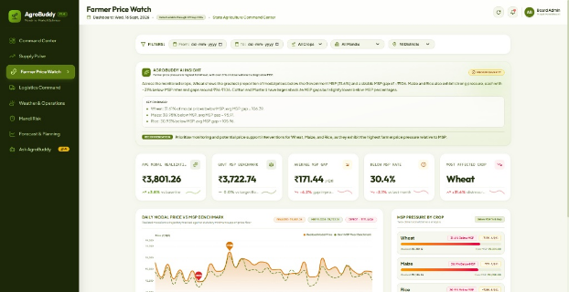
SHOCK REVELATION
"THE AVERAGE HIDES THE FARMER"
THE AVERAGE LOOKS HEALTHY. THE TRUTH DOESN'T!
LIVE VIEW: FARMER PRICE WATCH
AVG MODAL ₹3,801 (+₹78 ABOVE MSP)
30.4%
PRICE OBSERVATIONS BELOW MSP!
Wheat
Maize
Rice
31.6%
30.9%
30.9%
Cotton
Mustard
Sugarcane
30.6%
29.3%
29.0%
⚡ KEY TAKEAWAY: Cotton & Mustard show deeper rupee shortfalls despite fewer instances than Wheat.

Slide 5

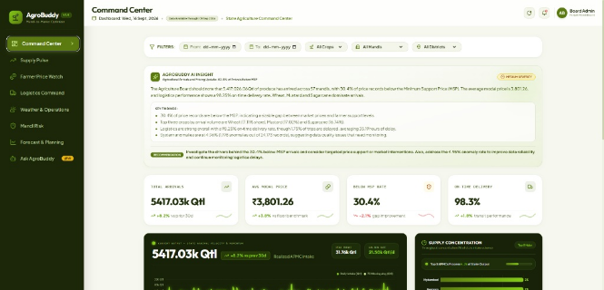
SYSTEM BLUEPRINT
FROM 5 DASHBOARDS TO ONE DECISION SURFACE!
COMMAND CENTER UNIFIED
LIVE VIEW: COMMAND CENTER
AGROBUDDY ENGINE
DuckDB + FastAPI + ML + Groq Copilot
1. OBSERVE SIGNAL (Arrivals, Price, Logistics, Weather)
2. DIAGNOSE CAUSE (Cross-Domain Risk Engine)
3. PREDICT RISK (7-Day ML Supply Horizon)
4. EXECUTE ACTION (Board Policy Intervention)
AGROBUDDY MOTTO: Every dashboard is merely a lens over one underlying intelligence model.

Slide 6

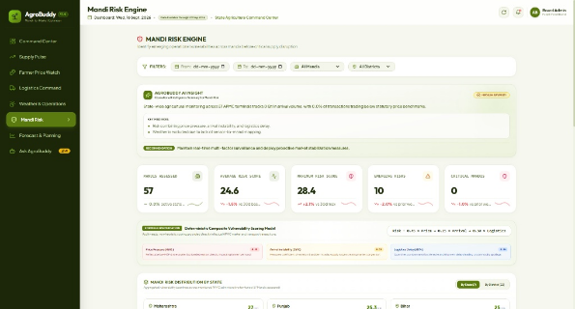
CHAPTER 3: RISK RADAR
RISK DOESN'T LIVE IN ONE METRIC!
DETERMINISTIC COMPOSITE MODEL
LIVE VIEW: MANDI RISK ENGINE
RISK = (0.45 × PRICE) + (0.25 × ARRIVALS) + (0.30 × LOGISTICS)
DUAL STRESS ZONE
TRANSIT BOTTLENECK
Price slump + transit choke
Delayed routes, steady price
PRICE VULNERABLE
BASELINE NORMAL
Smooth transit, below MSP
On-time drops, fair prices
"The score tells where to look. The drivers explain why."
⚡ DUAL-ACTION: Stops blanket subsidies — targets intervention to route bottlenecks or price floors directly.

Slide 7

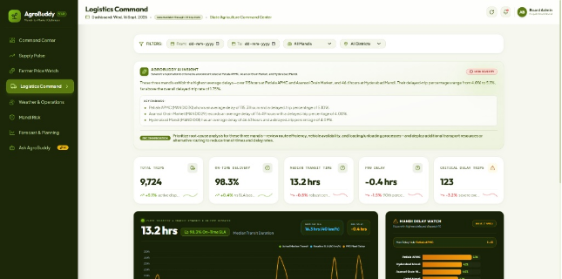
CHAPTER 4: LOGISTICS PARADOX
98.3% ON-TIME... UNTIL YOU ZOOM IN!
ROUTE CORRIDOR ANALYSIS
LIVE VIEW: LOGISTICS COMMAND
TRIP LEVEL (AGGREGATE)
98.3%
On-time delivery across 9,724+ trips
CORRIDOR LEVEL (REALITY)
70.2%
Corridors meeting benchmark (342 total)
⚠️ 123 Critical Delay Trips Identified
💥 OPERATIONAL INSIGHT: Distance explains the journey. It does NOT explain the delay.

Slide 8
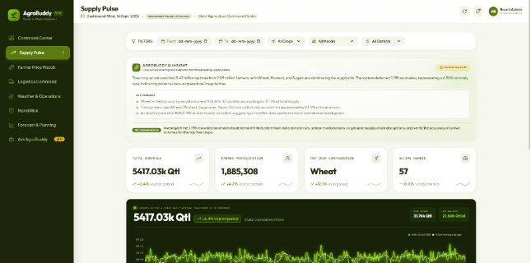
CHAPTER 5: SUPPLY INTELLIGENCE
SUPPLY IS MOVING — BUT NOT PREDICTABLY!
5.417M QTL TOTAL ARRIVALS
LIVE VIEW: SUPPLY PULSE
VOLUME: NO SINGLE MONOPOLY
Top 5 Crops = 83.8% of aggregate mandi intake. Wheat (926k) & Mustard (922k) lead with balanced shares.
VOLATILITY: INFLOW SHOCKS (CV)
Sugarcane
34.2% CV
Rice
33.1% CV
Wheat
33.0% CV
🎯 AgroBuddy doesn't just measure total supply. It measures supply predictability.

Slide 9
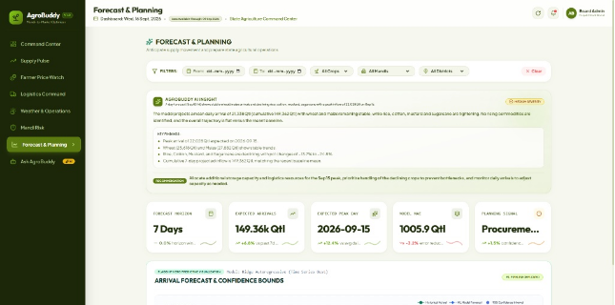
CHAPTER 6: LOOKING AHEAD
WHAT HAPPENS IN THE NEXT 7 DAYS?
PREDICTIVE SUPPLY PLANNING
LIVE VIEW: FORECAST & PLANNING
PROJECTED 7-DAY INFLOW
149.36k Qtl
Ridge Autoregressive ML Model (MAE: 1,005.9)
COMMODITY PLANNING SIGNALS
Wheat: -3.8% Stable
Maize: -4.9% Stable
Rice: -13.7% Tight
Mustard: -21.7% Tight
💡 CORE PRINCIPLE: The forecast isn't the output. The planning signal is.

Slide 10
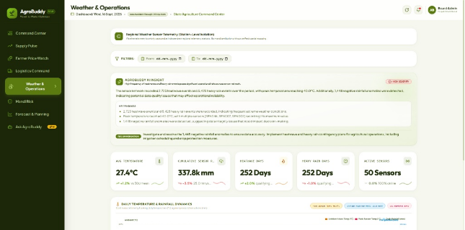
CHAPTER 7: TRUST ARCHITECTURE
THE WEATHER PROBLEM WE REFUSE TO FAKE!
ZERO HALLUCINATION GUARD
LIVE VIEW: WEATHER & OPERATIONS
BOARD QUERY:
"Which mandi was affected most by rainfall?"
AGROBUDDY VERIFIED REFUSAL:
"I analyze rainfall patterns across 50 telemetry nodes, but I lack validated sensor-to-mandi coordinate links. I refuse to fabricate mandi attribution without ground truth."
🛡️ GROUNDED AI: It isn't just about answering correctly. It's about refusing to invent!

Slide 11
CHAPTER 8: AI SEPARATION OF POWERS
WE DIDN'T PUT AN LLM EVERYWHERE!
2 SPECIALIZED BRAINS
PASSIVE AI • INSIGHT ENGINE
ACTIVE AI • AGROBUDDY GRAPH
DASHBOARD EXPLAINER
QUESTION SOLVER
• Reads Pre-Aggregated Context
• Natural Language Intent Parser
• Groq High-Speed Inference
• Deterministic Semantic Queries
• Produces Executive Briefs
• Dynamic ECharts Compilation
"Explains what the dashboard is showing"
"Generates custom charts on the fly"
AI HANDLES LANGUAGE. DETERMINISTIC ANALYTICS HANDLES TRUTH.

Slide 12

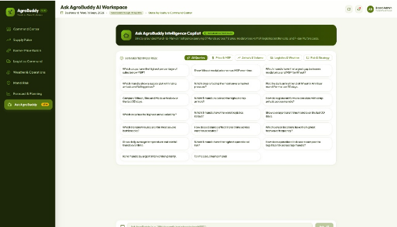
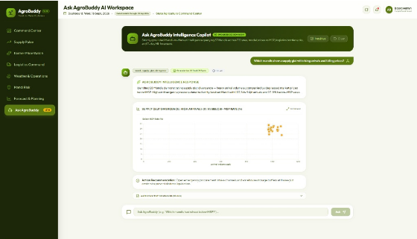
CHAPTER 9: INTERACTIVE GRAPH IN ACTION
ASK AGROBUDDY: MULTI-HOP QUERIES
LIVE AGENT DEMO
STEP 1: NATURAL LANGUAGE INTENT DISCOVERY
STEP 2: DYNAMIC CHART SPECIFICATION & ACTION
⚡ PROOF: AgroBuddy does NOT retrieve canned charts. It compiles fresh ECharts specifications dynamically!

Slide 13
CHAPTER 10: ARCHITECTURAL SECURITY
FROM NATURAL LANGUAGE TO SAFE ACTION!
TYPED INTENT PIPELINE
01
02
03
04
05
06
USER
INTENT
VALIDATE
ANALYZE
VISUALIZE
ACTION
Voice/Text
LangGraph
Schema Lock
DuckDB
ECharts
Brief
❌ BANNED: LLM executing arbitrary raw SQL against the database
✅ AGROBUDDY: LLM → Validated Typed Intent → Deterministic Analytics
💬 CORE TAKEAWAY: "The agent chooses the question's shape — not the database's truth."

Slide 14
FINALE • THE NEW BOARD OPERATING SYSTEM
THE AGRICULTURE BOARD'S NEW DECISION LOOP!
OBSERVE
DIAGNOSE
PREDICT
PRIORITIZE
ACT
5 Signal Feeds
Cross-Domain Risk
7-Day Supply Outlook
Mandi Vulnerability
Operational Policy
"AGROBUDDY DOES NOT REPLACE HUMAN JUDGMENT — IT GIVES IT A BETTER VIEW OF THE FIELD!"
From Raw Mandi Data to High-Confidence Board Decisions.

Slide 15
FULL-STACK PIPELINE SPECIFICATION!
TIER 1: STORAGE
TIER 2: ENGINE
TIER 3: AGENTS
TIER 4: CLIENT
INGEST & STORAGE
CORE API & ENGINE
INTELLIGENCE
PRESENTATION
• Raw CSV / Multilingual ETL
• FastAPI Async Server
• LangGraph State Machine
• React 18 Modular Views
• Partitioned Parquet Storage
• Semantic Analytics Layer
• Groq High-Speed LLM
• Apache ECharts Visuals
• In-Memory DuckDB Queries
• Pydantic Typed Validation
• Scikit-Learn Forecasting
• Tailored Decision Surfaces
SUB-SECOND COLUMNAR
STRICT SCHEMA BOUNDS
HYBRID REASONING
DYNAMIC COMPILATION
⚡ ZERO BOTTLENECK ARCHITECTURE: Columnar Parquet + in-memory DuckDB guarantees sub-second response on 63k+ records.

Slide 16

THE MISSION CONTINUES
AGROBUDDY • MISSION CONTROL DEPLOYED
V1.0 LIVE PRODUCTION
ACCESS PLATFORM & REPOSITORY
LIVE APP:
agro-buddy-psi.vercel.app
VERCEL
GITHUB:
shayan-codes-405/agro-buddy
OPEN SOURCE
MISSION TEAM & CONTRIBUTORS
Harsh Singh
Shayan Akhtar
ID: 1237841
ID: 12317465
MD Zaki Zafar
Ayush Pandey
ID: 12317465
ID: 12319468
BUILT FOR IMPACT • READY TO DEPLOY FOR STATE APMC AUTHORITIES

